Slide 1
CZ2007 Introduction to Database Systems

Slide 2
Recap
name
addr
name
price
Employ
Persons
Buy
Products
country
Make
Companies
category
name
Entity Sets
Relationships (Many-to-Many, Many-to-One, One-to-One)

Slide 3
Students
Mentor
Faculties
Each student is mentored by one faculty
Each faculty can mentor multiple students

Slide 4
Roles
Husband
Persons
Married
Wife
Sometimes an entity set may appear more than once in a relationship
Example: some persons are married
The role of the person is specified on the edge connecting the entity set to the relationship
Husband | Wife
Bob | Alice
David | Cathy
… | …

Slide 5
Roles
Supervisor
Employees
Supervise
Supervisee
Example: some employee supervise other employees
Without the roles, it is unclear whether it is many-to-one from supervisees to supervisors, or the other way around

Slide 6
One More Thing about Relationships
A relationship can have its own attribute
name
addr
name
price
Persons
Buy
Products
category

Slide 7
One More Thing about Relationships
A relationship can have its own attribute
If we want to record the date of the purchase
name
addr
name
price
Persons
Buy
Products
date
category

Slide 8
Exercise
Consider two entity sets, Shops and Companies
Each shop sells products from at least one company
Each company has its product sold at least one shop
A shop may be the flagship shop of at most one company
Each company has at least one flagship shops
Draw some relationships between Shops and Companies to capture the above statements

Slide 9
There can be multiple relationships between two entity sets

Slide 10
Roadmap
Constraints
Subclasses
Weak Entity Sets
ER Design Principles

Slide 11
Constraints
Some conditions that entity sets and relationships should satisfy
We will focus on three types of constraints
Key constraints
Referential integrity constraints
Degree constraints

Slide 12
Key
name
addr
Persons
One or more attributes that are underlined
Meaning: They uniquely represent each entity in the entity set
Example: The names uniquely represent the persons
i.e., each person must have a unique name

Slide 13
Key
name
price
Products
category
One or more attributes that are underlined
Meaning: They uniquely represent each entity in the entity set
Example: Each product has a unique name

Slide 14
Key
name
price
Products
category
One or more attributes that are underlined
What now?
Each product has a unique <name, category> combination
But there can be products with the same name, or the same category, but not both
Example
Name = “Apple”, Category = “Fruit”, Price = “1”
Name = “Apple”, Category = “Phone”, Price = “888”

Slide 15
Key
name
price
Products
category
Rule: Every entity set should have a key
So that we can uniquely refer to each entity in the entity set

Slide 16
Referential Integrity
Companies
Make
Products
One company may make multiple products
One product is made by one company
Can there be a product that is not made by any company?
No.
i.e., every product must be involved in the Make relationship
This is called a referential integrity constraint.
How do we specify this in an ER diagram?
Use a rounded arrow instead of a pointed arrow

Slide 17
Referential Integrity
Companies
Make
Products
One company may make multiple products
One product is made by one company
Can there be a product that is not made by any company?
No.
i.e., every product must be involved in the Make relationship
This is called a referential integrity constraint.
How do we specify this in an ER diagram?
Use a rounded arrow instead of a pointed arrow

Slide 18
Referential Integrity
Companies
Make
Products
What if every company should make at least one product?
No arrow there….
In general, a referential integrity constraint can only apply to the “one” side of
A many-to-one relationship, or
A one-to-one relationship
Why? Will be clear later in this course
For the “many” side, there is another type of constraints to use (will be discussed shortly)

Slide 19
Referential Integrity: Exercise
Cities
Capital of
Countries
A city can be the capital of only one country
A country must have a capital

Slide 20
Referential Integrity: Exercise
Persons
Hire
Companies
A company must hire at least one person
A person must be hired by exactly one company

Slide 21
Degree Constraint
≥ 1
Companies
Make
Products
Each company should make at least 1 product

Slide 22
Degree Constraint
≤ 1000
Companies
Make
Products
Each company can make at most 1000 product
Note
Not required in the quiz/exam
Degree constraints are not easy to enforce in a DBMS
Key and referential integrity constraints can be easily enforced

Slide 23
Roadmap
Constraints
Subclasses
Weak Entity Sets
ER Design Principle

Slide 24
Subclass
ID
PhDs
isa
Students
advisor
name
PhDs are a special type of Students
Subclass = Special type
The connection between a subclass and its superclass is captured by the isa relationship, which is represented using a triangle
Key of a subclass = key of its superclass
Example: Key of Phds = Students.ID
Students is referred to as the superclass of PhDs

Slide 25
Subclass
Desktops
isa
name
Computers
isa
price
Laptops
An entity set can have multiple subclasses
Example
Superclass: Computers
Subclass 1: Desktop
Subclass 2: Laptop

Slide 26
Roadmap
Constraints
Subclasses
Weak Entity Sets
ER Design Principle

Slide 27
Weak Entity Sets
Weak entity sets are a special type of entity sets that
cannot be uniquely identified by their own attributes
needs attributes from other entities to identify themselves
Example: Cities in USA
Problem: there are cities with identical names
name
Cities
population

Slide 28
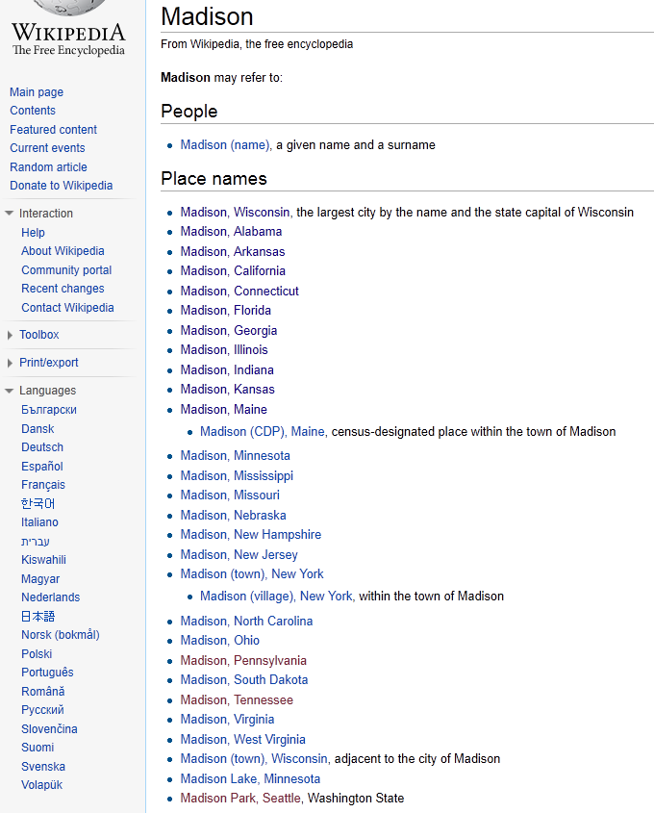

Slide 29
Weak Entity Sets
name
name
Cities
In
States
population
GDP
Problem: there are cities with identical names
Observation: cities in the same state would have different names
Solution: make Cities a weak entity set associated with the entity set States
The relationship In is called the supporting relationship of Cities
Weak entity set = Double-lined rectangle
Supporting relationship = Double-lined diamond
The key of Cities = (State.name, Cities.name)

Slide 30
Exercise
Consider two entity sets: Players and Teams
Each player has a name and a number
Each team has a name and a manager
Each player plays for exactly one team, and is uniquely identified within the team by his/her number
Each team is uniquely identified by its name
Different players may have the same name
Draw a ER diagram that captures the above statements
What is the key of Players?

Slide 32
Subclass vs. Weak Entity Sets
ID
PhDs
isa
Students
advisor
name
PhDs are a special type of Students
Cities are NOT a special type of States
name
name
Cities
In
States
population
GDP

Slide 33
ER Diagram Design: Exercise
Consider a mail order database in which employees take orders for parts from customers. The requirements are:
Each employee is identified by a unique employee number, and has a first name, a last name, and a zip code.
Each customer is identified by a unique customer number, and has a first name, last names, and a zip code.
Each part being sold is identified by a unique part number. It has a part name, a price, and a quantity in stock.
Each order placed by a customer is taken by one employee and is given a unique order number. Each order may contain certain quantities of one or more parts. The shipping date of each part is also recorded.

Slide 35
Roadmap
Constraints
Subclasses
Weak Entity Sets
ER Design Principles

Slide 36
Design Principle 1: Be Faithful
Be faithful to the specifications of the application
Capture the requirements as much as possible

Slide 37
Design Principle 2: Avoid Redundancy
Avoid repetition of information
Example
Problems that can be caused by redundancy
Waste of space
Possible inconsistency
ID
ID
Students
Mentor
Faculties
name
name
mentor

Slide 38
Design Principle 3: Keep It Simple
Each student is mentored by one faculty
One faculty can mentor multiple students
We also record the number of times that a mentee meets with his/her mentor
Design below: Not wrong, but can be simplified
number
Meet
Students
Faculties
Mentor

Slide 39
Design Principle 3: Keep It Simple
Each student is mentored by one faculty
One faculty can mentor multiple students
We also record the number of times that a mentee meets with his/her mentor
Better Design:
number
Students
Faculties
Mentor

Slide 40
Design Principle 3: Keep It Simple
There are four types of students: Year 1, Year 2, Year 3, Year 4
Design below: Not wrong, but can be simplified
isa
Year 1
isa
Year 2
Students
isa
Year 3
isa
Year 4

Slide 41
Design Principle 3: Keep It Simple
There are four types of students: Year 1, Year 2, Year 3, Year 4
Better Design
year
Students

Slide 42
Tips: When to Use Subclasses
Case 1: When a subclass has some attribute that is absent from the superclass
ID
PhDs
isa
Students
advisor
name
Case 2: When a subclass has its own relationship with some other entity sets
Companies
Employ
Part-Time
isa
Students

Slide 43
Design Principle 4: Don’t Over-use Weak Entity Sets
Cities
In
States
In
Countries
In
Departments
In
Universities
In
Students
Too many entity sets that should not be “weak”

Slide 44
Design Principle 4: Don’t Over-use Weak Entity Sets
Note: For your lab project, use weak entity sets whenever appropriate and don’t worry about over-use
Cities
In
States
In
Countries
In
Departments
In
Universities
In
Students
Too many entity sets that should not be “weak”

